Slide 1
Module 3
C. Micro-instruction

Slide 2
Content
Control Organization
Control Memory
Control Word, Macro-instruction, Micro-program
Organization of micro programmed control unit
Microinstruction Format

Slide 3
Control Organization
Two major types of control organization: hardwired control and microprogrammed control.
In the hardwired organization, the control logic is implemented with gates, flip-flops, decoders, and other digital circuits.
  It can be optimized to produce a fast mode of operation
  Changes are done in the wiring among various components if the design requires changes/modifications.
In the microprogrammed organization, the control information is stored in a control memory.
  The control memory is programmed to initiate the required sequence of microoperations.
  Any required changes/modifications can be done by updating the microprogram in control memory.

Slide 4
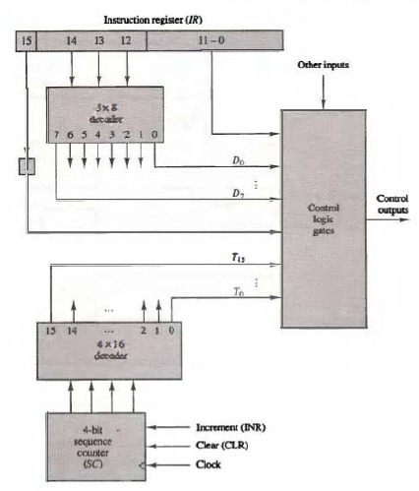
1. Hardwired Control for the basic computer
Fig. 1 [1] Hardwired control unit

Slide 5
Control Memory
A computer that employs a microprogrammed control unit will have two separate memories: a main memory and a control memory.
The contents of main memory may alter when the data are manipulated and every time when the program is changed.
Control Memory is the storage in the microprogrammed control unit to store the microprogram. It holds a fixed microprogram that cannot be altered by the occasional user.
The microprogram consists of microinstructions that specify various internal control signals for execution of register microoperations

Slide 6
Control Word, Microinstruction, Micro-program
Control Word:
The control variables at any given time can be represented by a string of 1 's and 0's called a control word.
Micro instruction
Each word in control memory contains a microinstruction.
The microinstruction specifies one or more microoperations for the system.
Each symbolic microinstruction is divided into five fields: label, microoperations, CD, BR, and AD.
Micro-program
A sequence of microinstructions constitutes a microprogram.
Alterations of the microprogram are not needed once the control unit is in operation, and so the control memory can be a read-only memory (ROM).

Slide 7
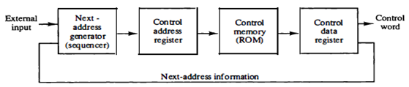
Organization of Micro-Programmed Control Unit
The control memory is assumed to be a ROM, within which all control information is permanently stored.
The “control address register” in control memory specifies the address of the microinstruction, and the “control data register” holds the microinstruction read from memory.
The microinstruction is a control word that specifies one or more microoperations for the data processor. Once these operations are executed, the control must determine the next address.
Fig. 2 [1] Microprogrammed control organization

Slide 8
Organization of Micro-Programmed Control Unit
The location of the next microinstruction may be the one next in sequence, or it may be located somewhere else in the control memory.
While the microoperations are being executed, the next address is computed in the next address generator circuit and then transferred into the control address register to read the next microinstruction.
  The next address generator is sometimes called a micro-program sequencer, as it determines the address sequence that is read from control memory.
The control data register holds the present microinstruction while the next address is computed and read from memory.
  The control data register is sometimes called a pipeline register.

Slide 9
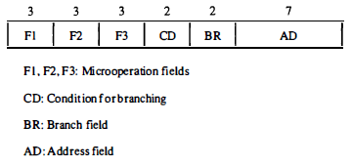
Microinstruction Format
The 20 bits of the microinstruction are divided into four functional parts as follows:
The microoperations are specified by 3 fields (F1, F2, and F3) of three bits each.
  The three bits in each field are encoded to specify 7 distinct microoperations. This gives a total of 21 microoperations.
The CD field selects status bit conditions.
The BR field specifies the type of branch to be used.
The AD field contains a branch address. The address field is 7 bits wide, since the control memory has 128 = 2⁷ words.
Fig. 3 [1] Microinstruction Format

Slide 10
Example Microinstruction
As an example, a microinstruction can specify two simultaneous microoperations from F2 and F3 and none from F1.
DR <-- M[AR] with F2 = 100
PC <-- PC + 1 with F3 = 101
The nine bits of the micro-operation fields will then be 000 100 101.
It is important to note that two or more conflicting microoperations cannot be specified simultaneously.
For example, a microoperation field 010 001 000 has no meaning because it specifies the operations to clear AC to 0 and subtract DR from AC at the same time.

Slide 11
Symbolic Microinstructions
The microoperations field consists of one, two, or three symbols, separated by commas
  There may be no more than one symbol from each F field.
The NOP symbol is used when the microinstruction has no microoperations.
  This will be translated by the assembler to nine zeros.
The CD field has one of the letters: U, I, S, or Z.
The BR field contains one of the four symbols: JMP, CALL, RET, or MAP
The AD field specifies a value for the address field of the microinstruction

Slide 12
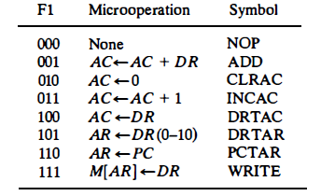
Micro-operations Fields
Each microoperation is defined with a register transfer statement and is assigned a symbol for use in a symbolic microprogram.
All transfer-type microoperations symbols use five letters.
  The first two letters designate the source register, the third letter is always a T, and the last two letters designate the destination register.
For example, the microoperation that specifies the transfer
AC <- DR (F1 = 100) has the symbol DRTAC, which stands for a transfer from DR to AC .
Fig. 4 [1] Micro-operations Fields (F1)

Slide 13
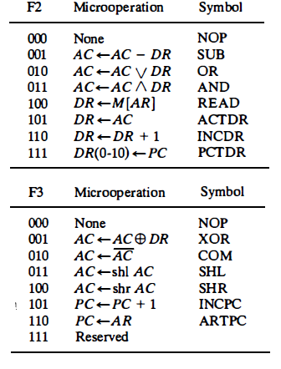
Micro-operations Fields F2 and F3
Fig. 5 [1] Micro-operations Fields (F2) and (F3)

Slide 14
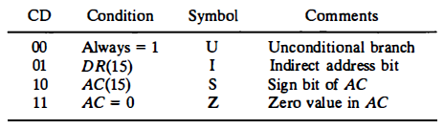
Condition field
The CD (condition) field consists of two bits which are encoded to specify 4 status bit conditions.
The first condition is always a 1, so that a reference to CD = 00 will always find the condition to be true. When this condition is used in conjunction with the BR field, it provides an unconditional branch operation.
The indirect bit I is available from bit 15 of DR after an instruction is read from memory.
The sign bit of AC provides the next status bit. The zero value, symbolized by Z, is a binary variable whose value is equal to 1 if all the bits in AC are equal to zero.
We will use the symbols U, I, S, and Z for the four status bits when we write microprograms in symbolic form.
Fig. 6 [1] Condition field (CD)

Slide 15
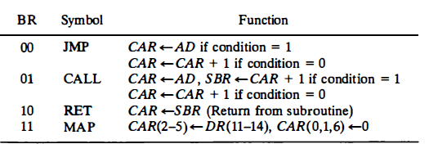
Branch field
The BR (branch) field consists of two bits. It is used, in conjunction with the address field AD, to choose the address of the next microinstruction.
when BR = 00, the control performs a jump GMP) operation (which is similar to a branch), and when BR = 01, it performs a call to subroutine (CALL) operation.
The return from subroutine i s accomplished with a B R field equal to 10. This causes the transfer of the return address from SBR to CAR .
The mapping from the operation code bits of the instruction to an address for CAR is accomplished when the BR field is equal to 1 1 .
Fig. 7[1] Branch field BR

Slide 16
References
[1]. M. Morris Mano, Computer System Architecture, Prentice Hall of India Pvt Ltd, 3rd Edition (upda ted) , 30 June 2017.
[2]. Tanenbaum & Austin, Structured Computer Organization, 6th Edition, Pearson Education
[3]. William Stallings, Computer Organization and Architecture–Designing for Performance, Ninth Edition, Pearson Education, 2013.

